Slide 2
2026/05/13 01:32 A.M.
UNIX TIMESTAMP: 1778607156
2026/05/13 01:32 A.M.
UNIX TIMESTAMP: 1778607155
2026/05/13 01:32 A.M.
UNIX TIMESTAMP: 1778607154
2026/05/13 01:32 A.M.
UNIX TIMESTAMP: 1778607157
Notes:
用動畫做時間流動的效果

Slide 3
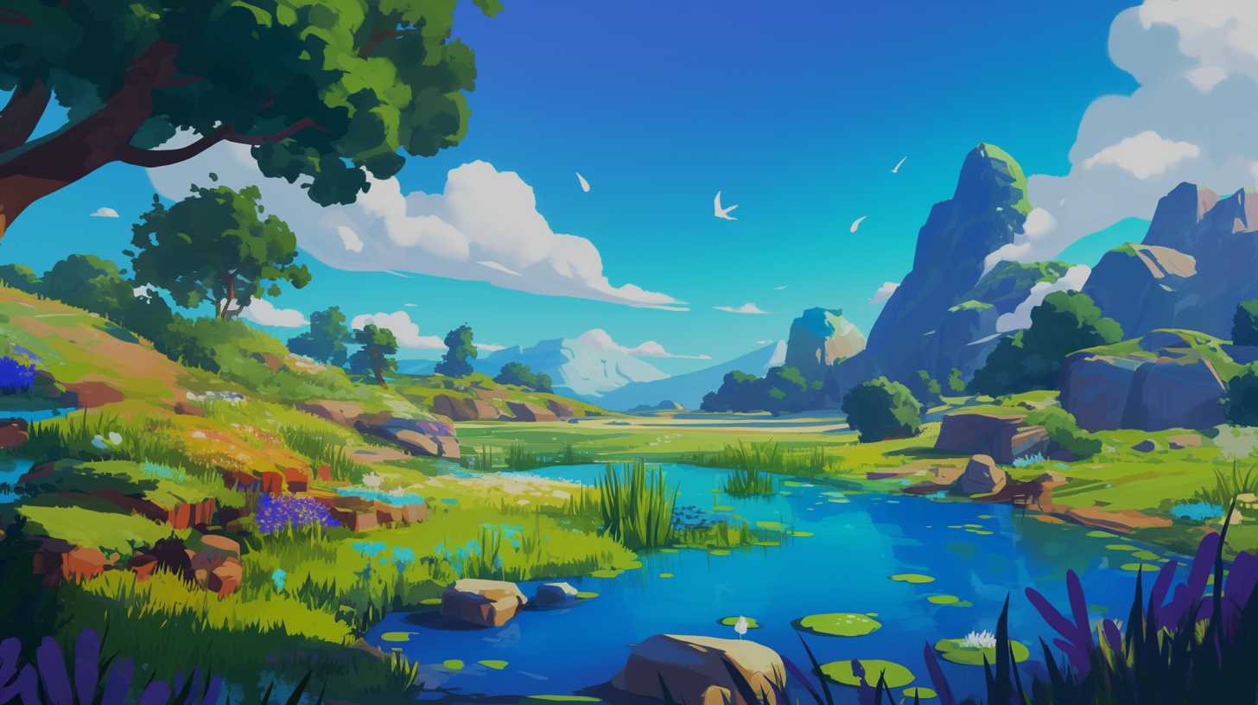


Slide 4
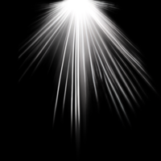
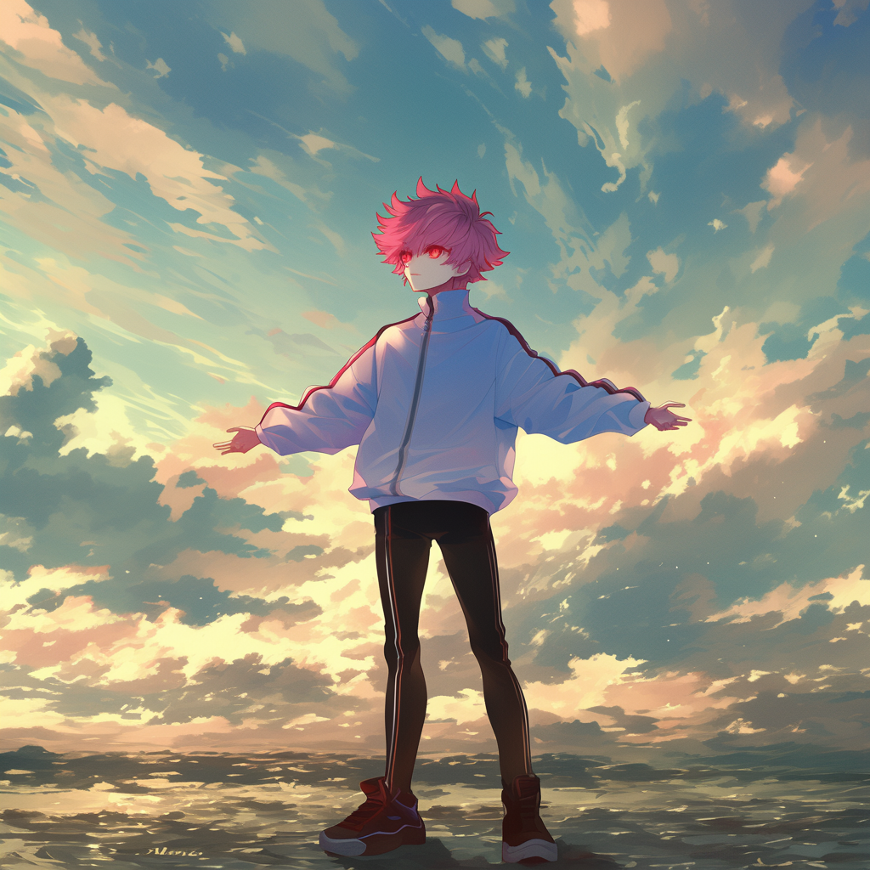
Notes:
使用Midjourney的niji6模型
有將自己的人設圖片餵給AI參考
Prompt:
A person standing in a serene landscape, arms outstretched, gazing towards the sky with a feeling of acceptance and serenity, embracing the vastness of the sky and receiving its blessings, under a dramatic cloudy or sunny sky with soft lighting and a gentle breeze, clean background --cref <圖片網址> --ar 1:1 --niji 6
並且後製素材

Slide 5
1. 目標

Slide 6
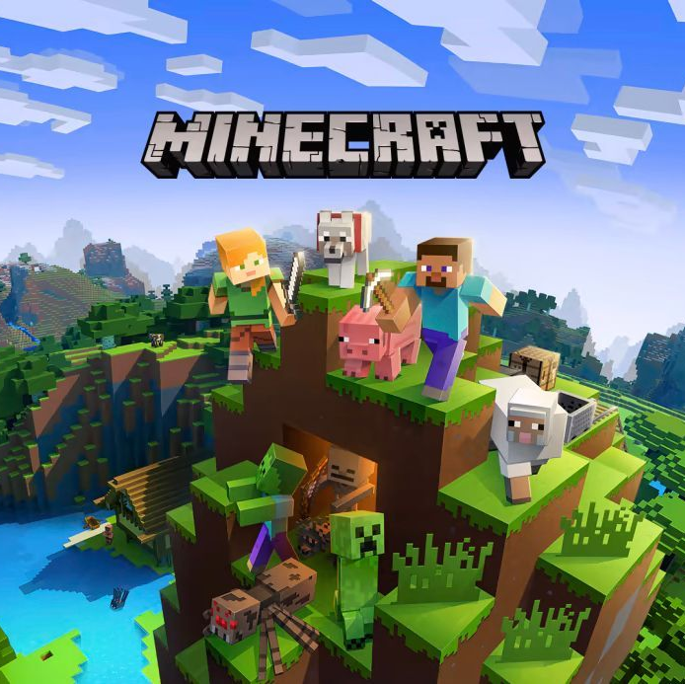

1. 目標

Slide 7

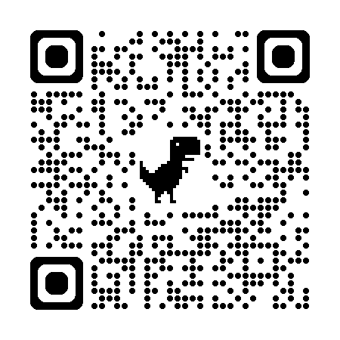
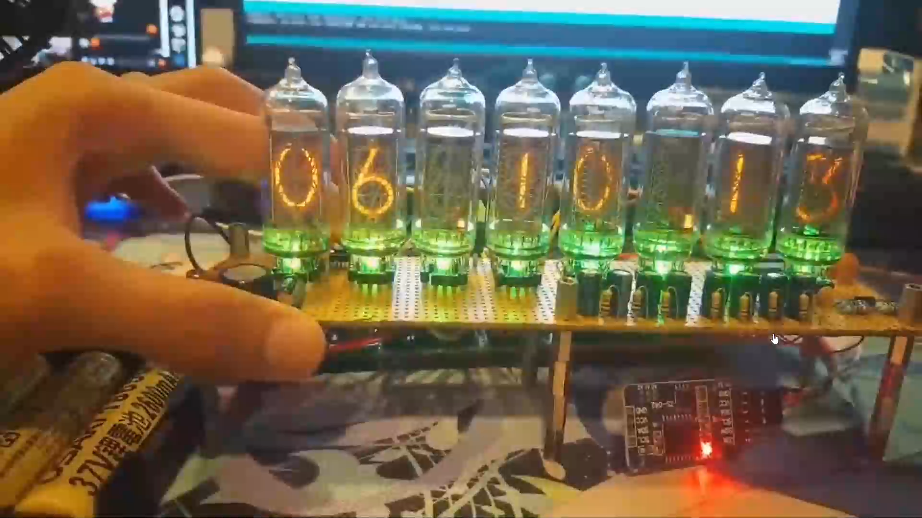
最喜歡的ACG作品： 《命運石之門》
之前做的酷東西！
1. 目標

Slide 8
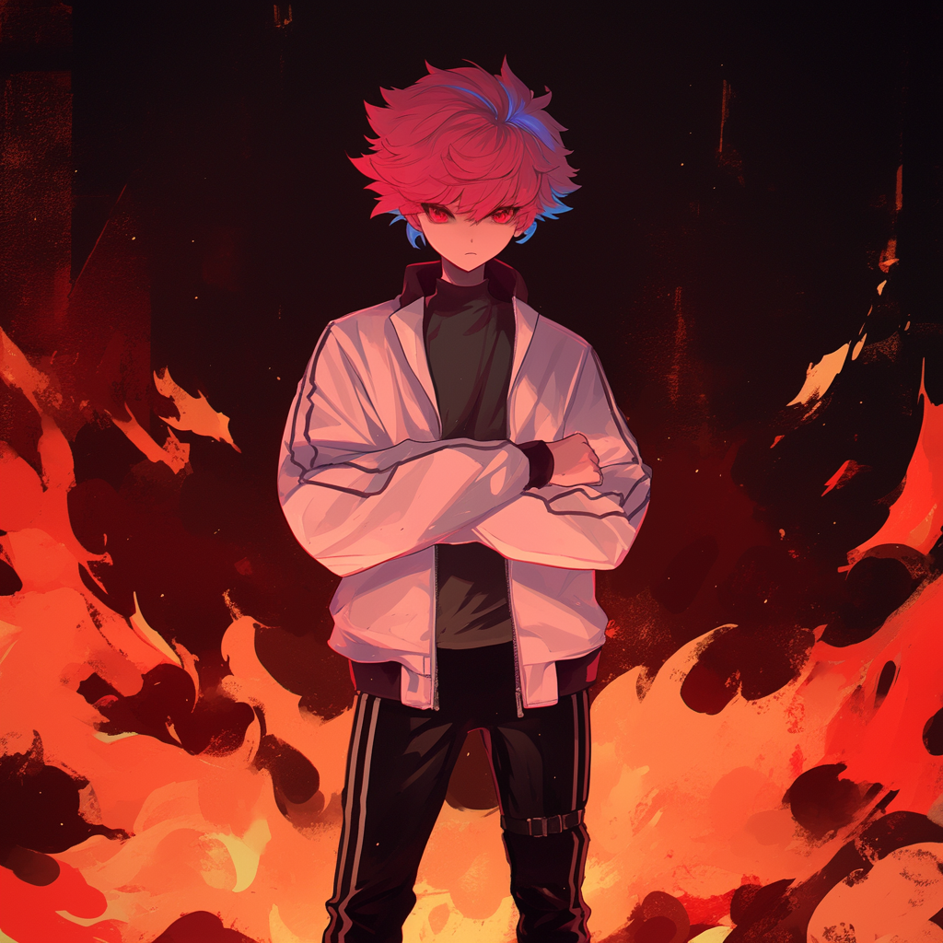
1. 目標
Notes:
同Clip02

Slide 9
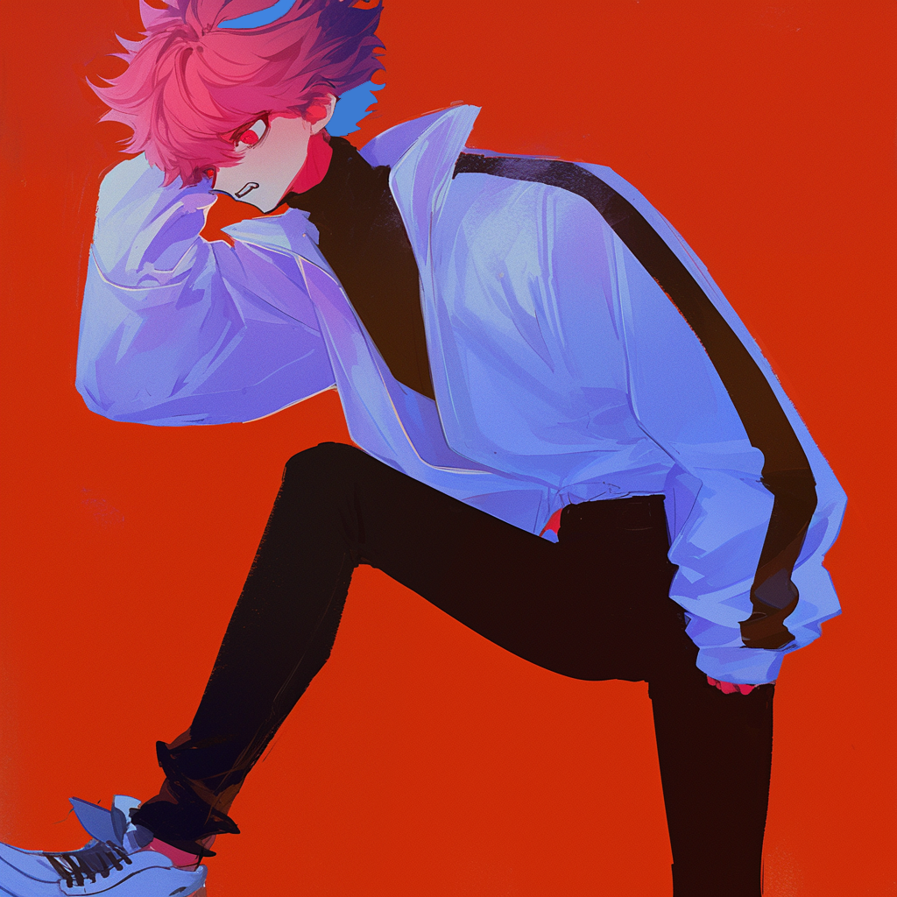
2. 阻礙
Notes:
使用Midjourney的niji6模型
有將自己的人設圖片餵給AI參考
Prompt:
A character clutching their head in distress, showcasing panic and anxiety, dramatic expression with a focus on emotional tension, soft lighting emphasizing facial features, surrounded by a minimalistic background to isolate the emotion. --cref <圖片網址> --niji 6 --ar 1:1
並稍微小修一下

Slide 10
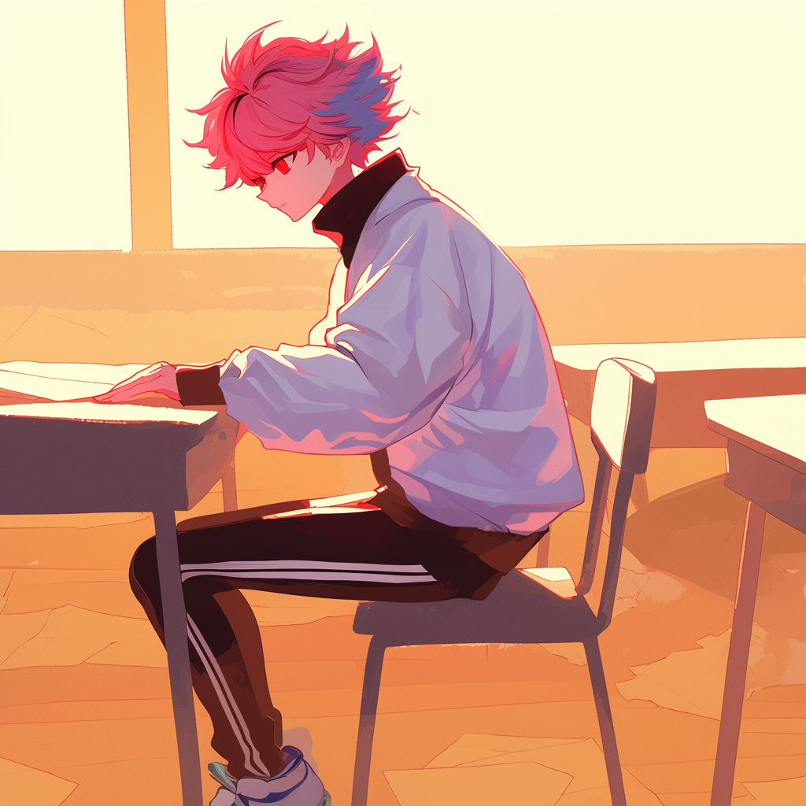
3. 努力
Notes:
使用Midjourney的niji6模型
有將自己的人設圖片餵給AI參考
Prompt:
attend an exam, write a question, in classroom --cref <圖片網址> --niji 6 --ar 1:1

Slide 11
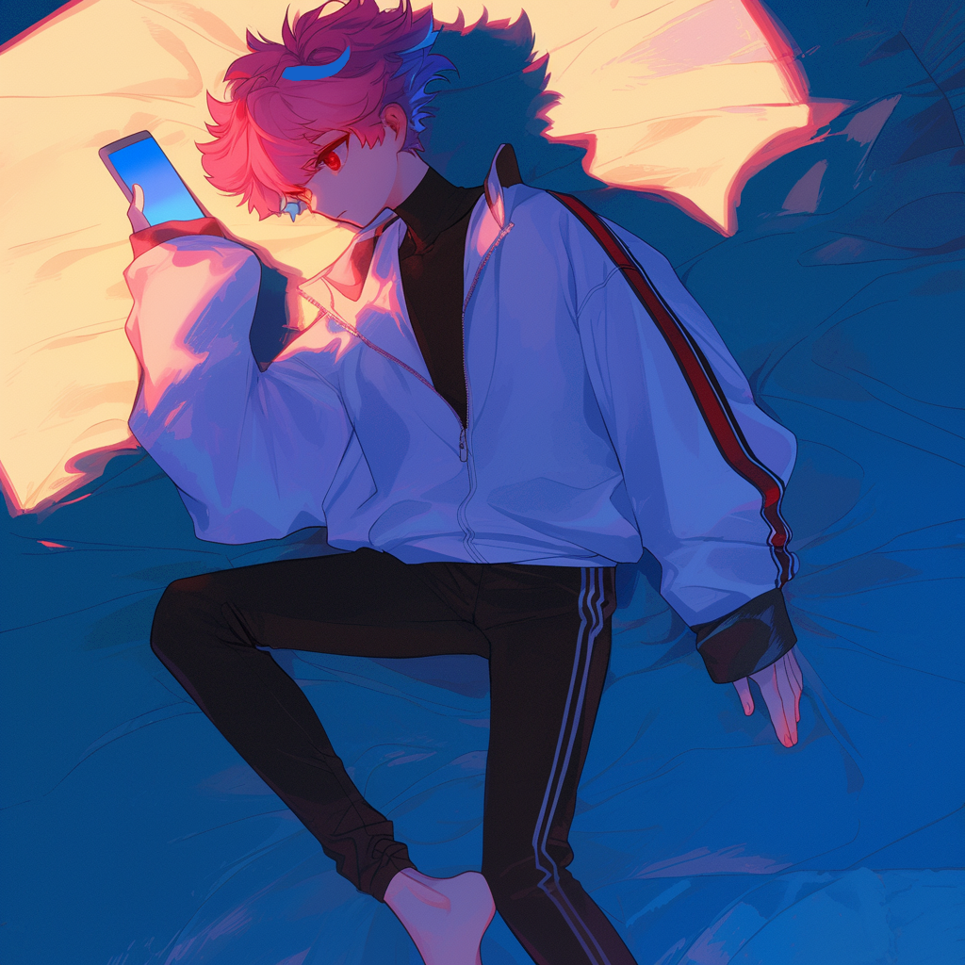
4. 結果
Notes:
同Clip02

Slide 12
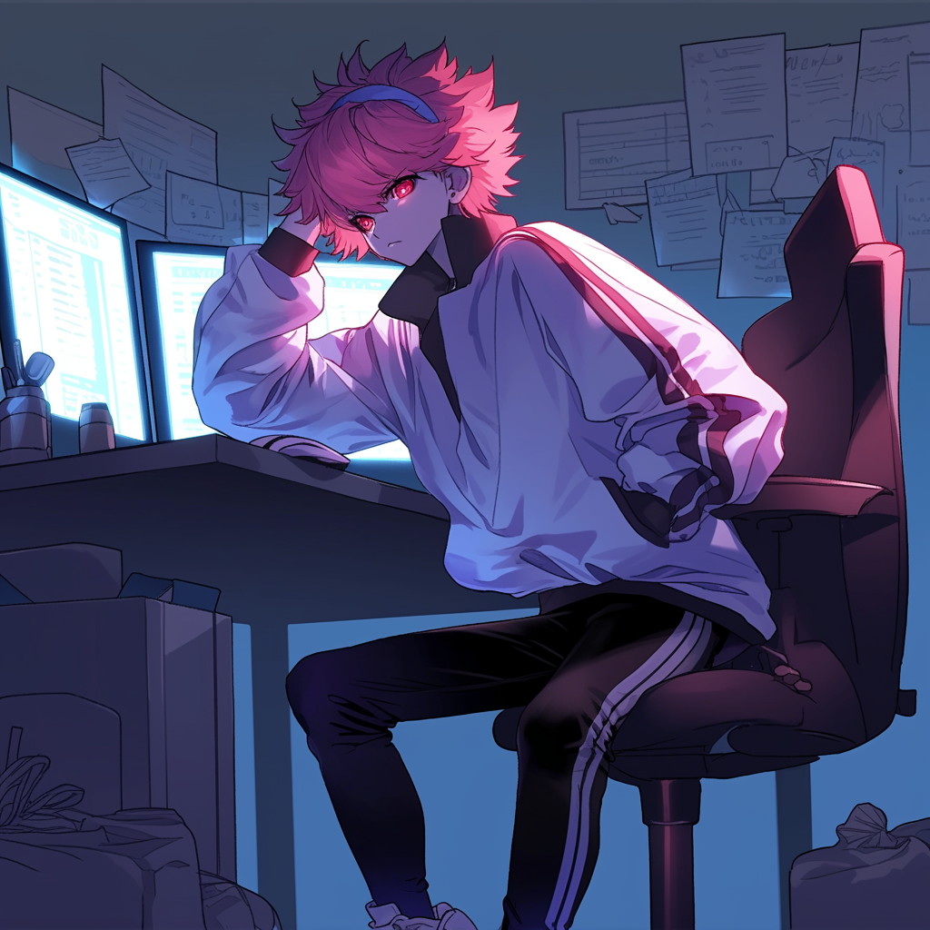
5. 意外
Notes:
同Clip02

Slide 13
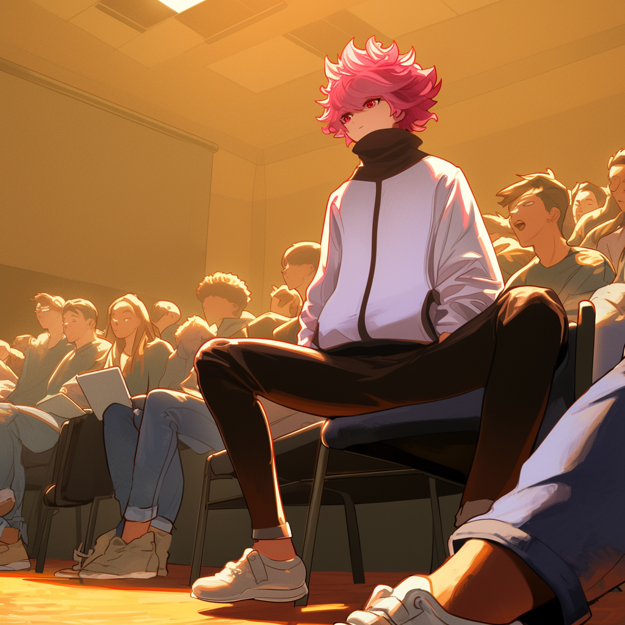
6. 轉彎
Notes:
同Clip02

Slide 14


6. 轉彎
Notes:
同Clip02

Slide 15
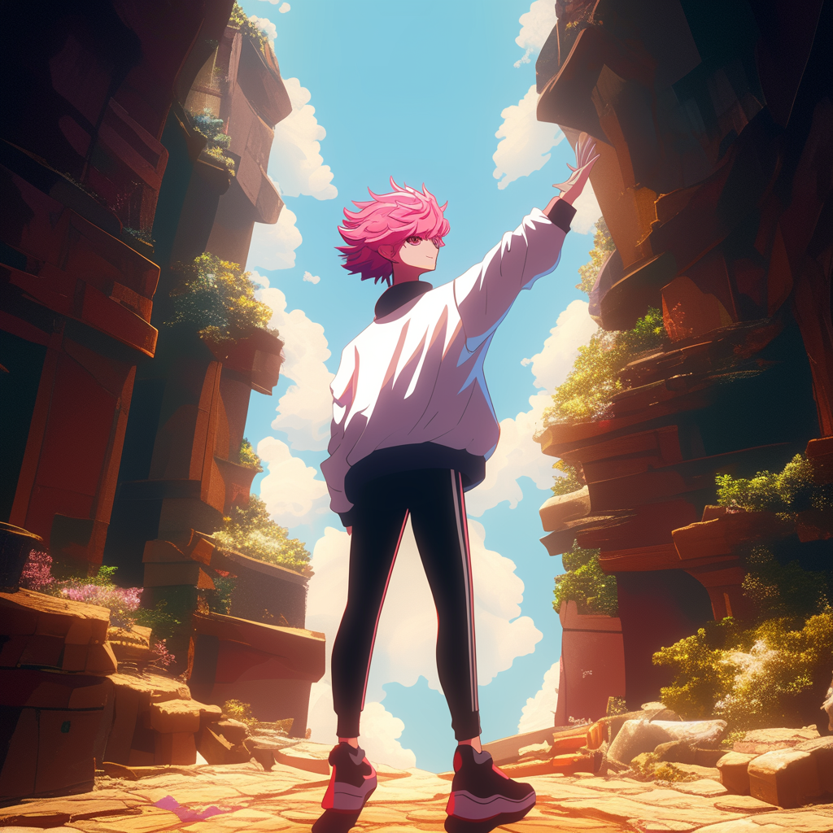
7. 結局
Notes:
使用Midjourney的niji6模型
有將自己的人設圖片餵給AI參考
Prompt:
candid photograph:2, A character standing in a game level scene, stylized 2D:2 world with fantasy elements. The character is not looking at the camera, facing away with their back towards the viewer:2, A person reaching out a single hand toward the sky, gazing upward with hope, highly detailed textures, cinematic lighting --cref https://s.mj.run/oP4BV2XKGOU --no eye to camera, face to camera, cowboy shot --niji 6 --ar 1:1

Slide 16
7. 結局

